Slide 1

Politecnico di Milano
A.A. 2015-2016
Software Engineering 2 project:
MyTaxiService
Alessandro Pozzi (matr. 852358),
Marco Romani (matr. 852361)

Slide 2
Requirements

Slide 3
Domain Assumptions
Requests and reservations can be cancelled if and only if no taxi have been assigned to the customer.
Customers are not allowed to request a taxi ride if any other request made by the same account has not been fulfilled yet.
Customers are allowed to perform unlimited taxi reservations. However, due to the fact that overlaps between two reservations are not predictable, the system will cancel any impracticable reservation identified at runtime.

Slide 4
Domain Assumptions
Taxi drivers will manually update their status (available or busy) with the mobile app every time they pick up or drop off standard customers. On the contrary, when drivers accept a ride request by MTS customers, the “busy” status will be automatically set up by the system. Anyway, the “available” status must still be selected manually after the customer has been taken to destination.
Payment and specific duties related to the taxi service are not considered and managed by the application. MyTaxiService is meant to be only an interface between customers and taxi drivers.
A taxi driver account cannot be used as a customer account, and vice versa. This means that if a taxi driver wants to access the customer’s services, he will need to create a customer account.

Slide 5
Domain Assumptions
If and only if a taxi zone does not have any taxi available to answer a request, the system will search for an available taxi in adjoining zones. Worst case scenario: if there are no taxi available in the adjoined zones, the costumer should be notified and put in hold. During this period of time the costumer should be allowed to cancel the request.
The web and mobile registration is intended for customers only. Taxi drivers’ account are created by an administrator when they are hired by the taxi company. Taxi drivers will then receive their username and temporary password, which they will be able to change once logged in the application.
MTS application won’t deal automatically unexpected behaviors of costumers that are habitually handled by taxi drivers. In detail, if customers leave an inconsistent origin or destination (which has been considered formally correct by the system), like an inexistent house number, drivers will use the instrument at their disposal (customer’s telephone, assistance number, etc.) to resolve the issue.

Slide 6
Goals and functional requirements
[G1] Allow customers to access the system’s taxi service in any moment, whether they are at home or anywhere else in the city.
[R1] Customers should be able to access the service through both the web and the mobile application, even at the same time.
[R2] Customers must be able to register to the taxi service from the mobile or web homepage.
[R3] Only registered customers can access MTS’s services.
[R4] The system should allow the log out functionality.

Slide 7
Goals and functional requirements
[G2] Allow customers to request a taxi ride from an arranged location.
[R1] Only registered customers can request a taxi ride.
[R2] Customers must insert a valid origin location in order to request a ride.
[R3] The system will not allow more than a request if the previous one (either request or reservation) has not been accomplished yet.

Slide 8
Goals and functional requirements
[G3] Allow customers to reserve a taxi ride at a specific time with a given origin and destination.
[R1] The system should allow taxi reservations for a specific path communicated by the customer.
[R2] The system must not allow overlaps between reservations (or requests) made by the same customer.
[R3] The system allows reservations only 2 hours before the time and date specified by the customer.
[R4] The system will assign a taxi driver for the reserved ride 10 minutes before the time and date specified by the customer.

Slide 9
Goals and functional requirements
[G4] Allow taxi drivers to answer a ride request and take care of customers.
[R1] Taxi drivers should be able to communicate their current availability state to the system.
[R2] If available, taxi drivers should be able to receive incoming requests.
[R3] After receiving an incoming request, the taxi driver should be able to either confirm or not his intention to take charge of the request.
[R4] Taxi drivers must be able to log in the mobile application with preassigned credential and be identified as drivers.

Slide 10
Goals and functional requirements
[G6] Allow customers to be notified of any relevant update connected to their requests and reservations.
[R1] The system should send updates through email and/or in-app notification, as specified by the customer.
[R2] Absence of taxis available, reservations overlaps, taxi average waiting time and taxi assigned to customers are events that must be notified to the customer.

Slide 11
Goals and functional requirements
[G7] Customers and taxi drivers must be able to contact each other after the system has paired them.
[R1] Customers must leave a valid phone number in order to complete the registration phase.
[R2] Taxi drivers must be able to access to the customer’s phone number when the system has paired them.
[R3] Customers must receive the taxi drivers’ contact number after the system has paired them.
[R4] Customers must receive the taxi code in order to be able to recognize its driver.

Slide 12
Goals and functional requirements
[G8] Allow customers to delete requests and reservations.
[R1] Customers can delete a request or reservation only if it has not been assigned to a taxi driver yet.

Slide 13
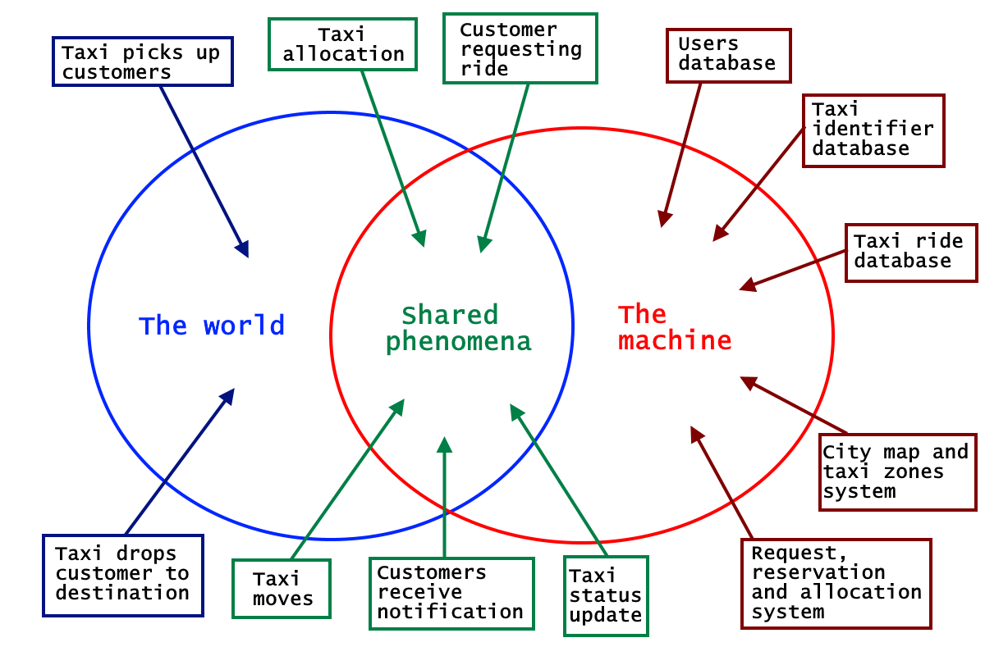
The world and the machine

Slide 14
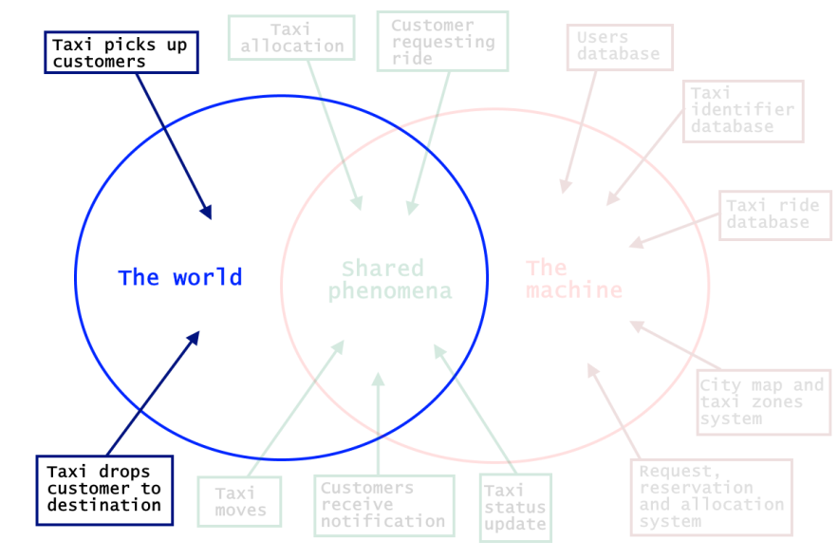
The world
Taxi picks up customers – happens exclusively in the world and it is not observed by the machine
Taxi drops customers to destination – it is not seen by the machine, which can only see the driver’s change of status

Slide 15
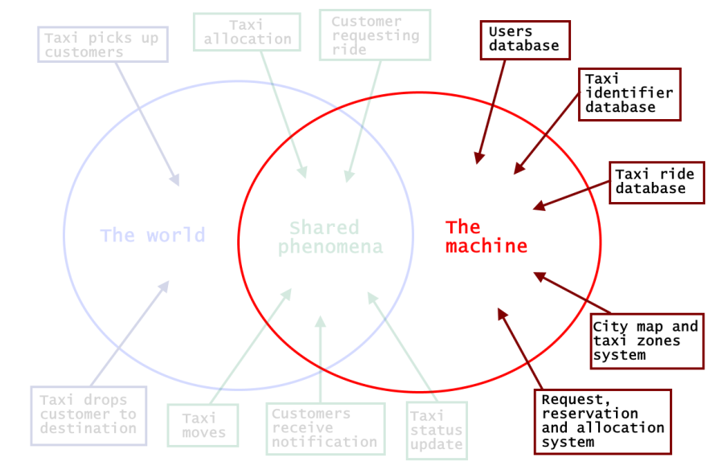
The machine
Users database – Contains all the users’ accounts: Admins, Taxi drivers and Customers
Taxi identifier database - contain all the information about taxis and their assigned drivers.
Taxi ride database - Store all the information regarding actual, past and future taxi rides
City map and taxi zones system – Contains and manages the taxi zones and the queues
Request, reservation and allocation system – manages the main application logic

Slide 16
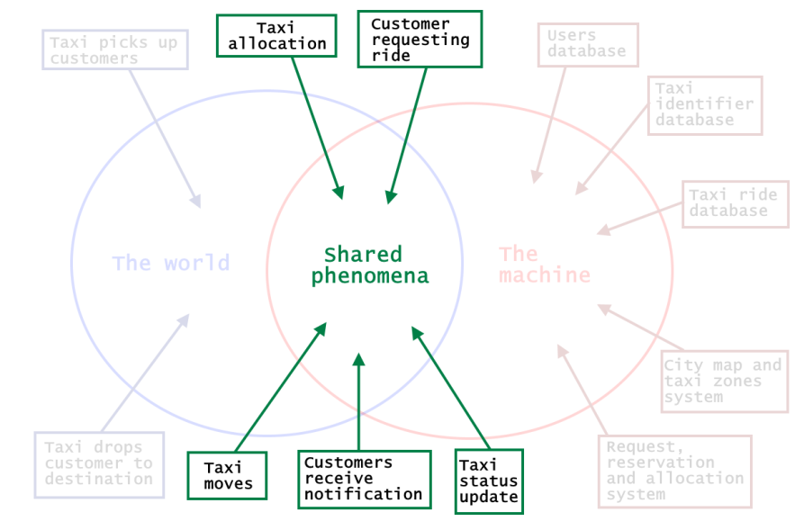
The Shared Phenomena
Taxi allocation - is a particular entity: for MTS customers it’s observed by the world and controlled by the machine; for standard customers it is observed by the machine (with the GPS and taxi zones system) and controlled by the world.
Customer requesting ride - happens in the world and is only observed by the machine, which will react accordingly.
Taxi moves - is a shared phenomenon, which is controlled by the world and observed by the machine through the GPS system.
Taxi status update - is also a phenomenon controlled by the world (i.e. the taxi driver that changes their status by picking up and dropping of customers) and observed by the system.
Customers receive notifications - is machine-controlled, since customers receive updates about their rides by the system.

Slide 17
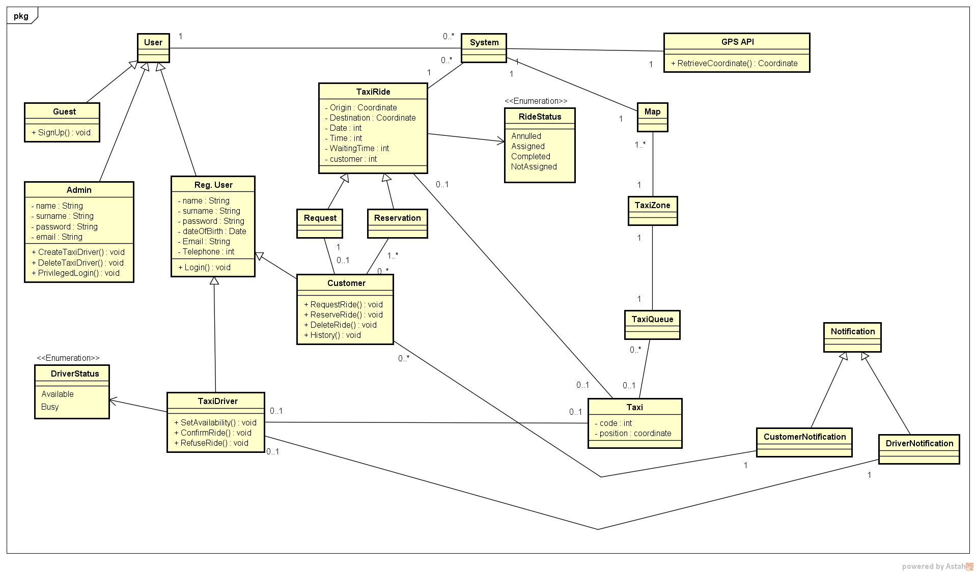
Class Diagram

Slide 18
Design

Slide 19
Problem overview
Different users communicating over the internet with a single system
Client-Server three-tier Architecture
Users can use different platforms (mobile and web)
The system accepts user’s requests and elaborate an answer in a short time
Event-based architecture with Publisher-Subscribe
The system must notify multiple users when some events occur

Slide 20
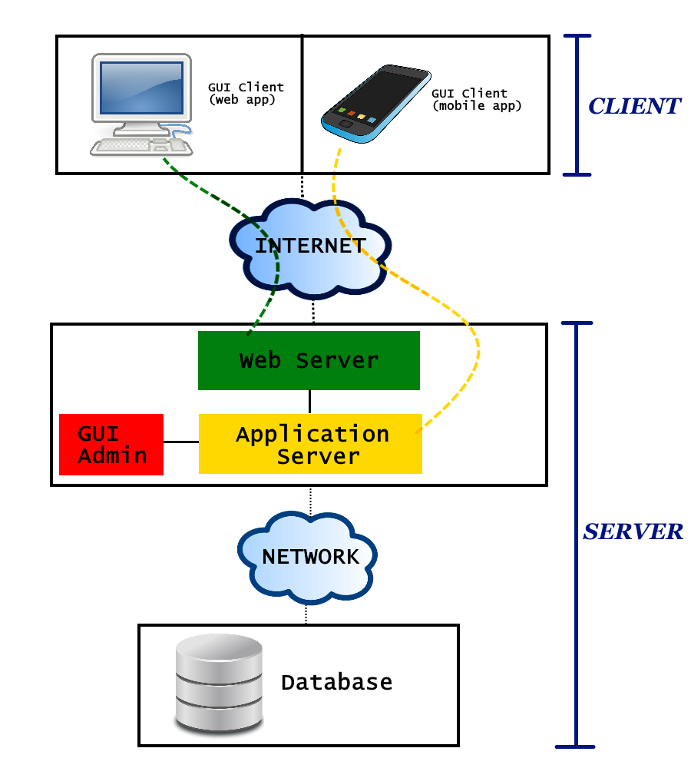
Three tier architecture
Top tier (Client)
The users’ machines (mobile phones and computers) will have the only purpose to load the Graphical User Interface (GUI)
No application logic is involved at this level
Clients will only be able to send requests to the web server and application server.

Slide 21
Three tier architecture
Middle tier
Web Server
Manages the web requests sent by clients using the web application.
If the request can be resolved with a static content page, the web server will generate and send the response itself.
If the request comports a dynamic content, the web server will delegate the dynamic response generation to the application server

Slide 22
Three tier architecture
Middle tier
Application Server
Contains the business logic
Provide lightweight APIs to be used directly by mobile application clients
Web application clients will access this component indirectly, through the Web Server.
Admin’s GUI
Specific interface for Administrators
Allows Admins to access to their exclusive functions dialoguing directly with the business logic

Slide 23
Three tier architecture
Bottom tier (Database)
Separated from the previous one with a (possibly local) network
Contains all the data that MyTaxiService needs to store

Slide 24
Event-based architecture
The core of MTS’s application logic is event-based:
Significant change of state (users modifying theirs account information, drivers changing status, etc)
Event
The system will handle it accordingly
Generates
In particular, the managing of the customer’s requests and taxi rides will be modeled with the publisher-subscribe pattern.

Slide 25
Publish-Subscribe pattern
CUSTOMER
TAXI RIDE
TAXI DRIVER
Asks for
Accepts the ride request and gets associated to the ride
The system generates
TOPIC
The customer is automatically subscribed to the topic and can receive its notifications
The driver is subscribed to the same topic too

Slide 26
Publish-Subscribe pattern
A logical component of the system that creates a publication on a topic when something relevant happens
Publisher
BROKER
An intermediary component that performs the queue management and the filtering of the messages
Filter messages based on their content, so that taxi drivers and customers related to the same topic won’t receive necessary the same notification or message
Subscribers
Messages are delivered to the subscribers (taxi drivers and customers)

Slide 27
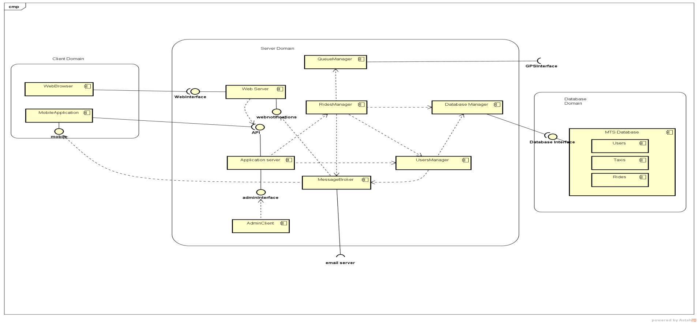
Components

Slide 28
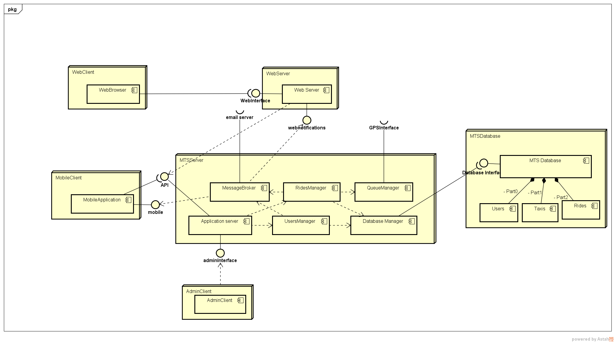
Deployment

Slide 29
Integration Test Plan

Slide 30
Integration Testing Plan
The components are divided in 3 subsystems:
Application Server
Web Server
Client
Each subsystem can be tested separately.

Slide 31
Integration Strategy
Application Server → Bottom-up strategy
Stubs will be used only for external component not to be tested (e.g. Client, Email Server, etc.)
Web Server and Client → No precise integration strategy is needed
They strongly rely on remote services and network communication
They deal with the Graphical User Interface
They can be tested without complex integrations (stubs and drivers provided)

Slide 32
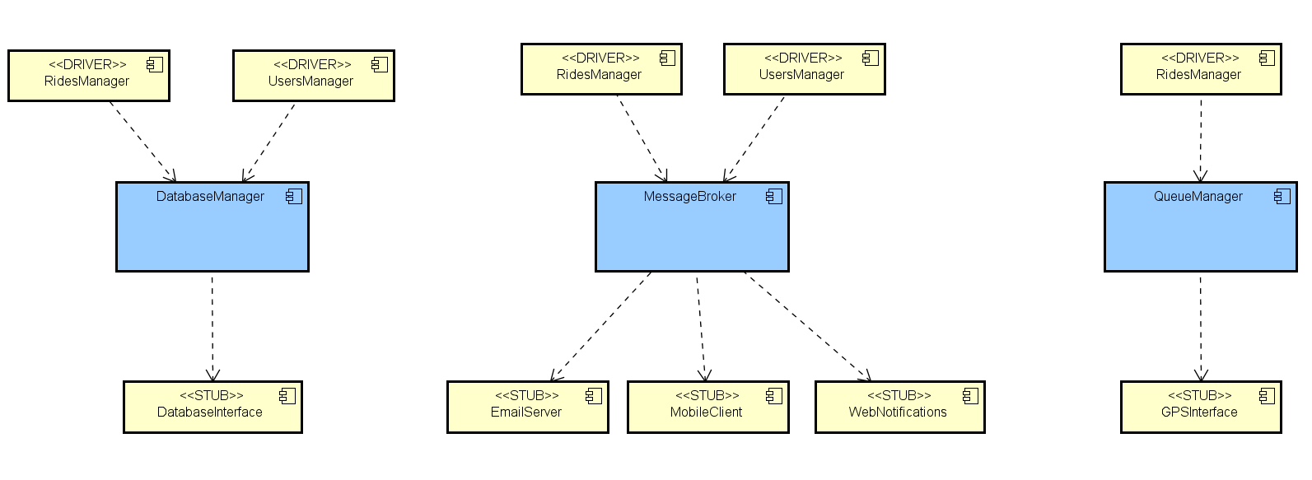
Application Server: Bottom-up testing
Step 1: DatabaseManager, QueueManager and MessageBroker are tested independently.
Next step: User Manager Integration

Slide 33
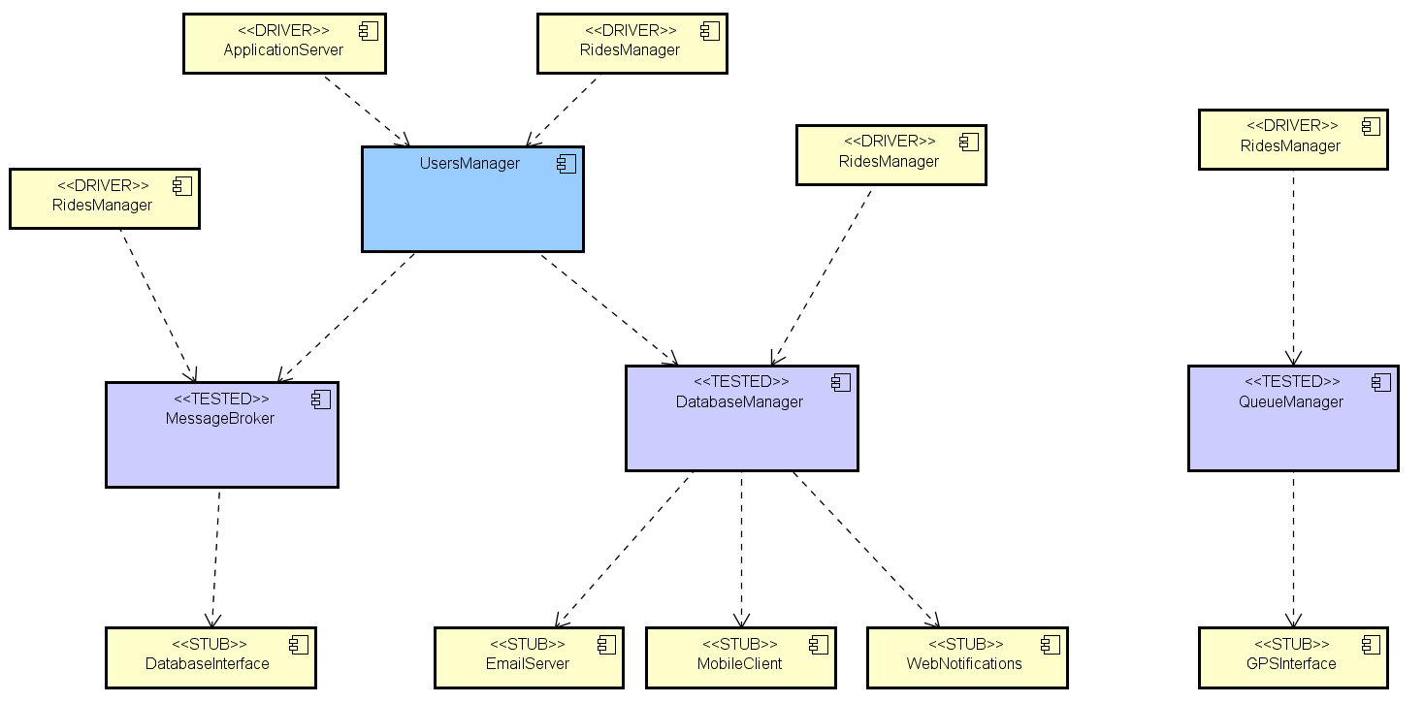
Step 2: User Manager.
Next step: Ride Manager Integration

Slide 34
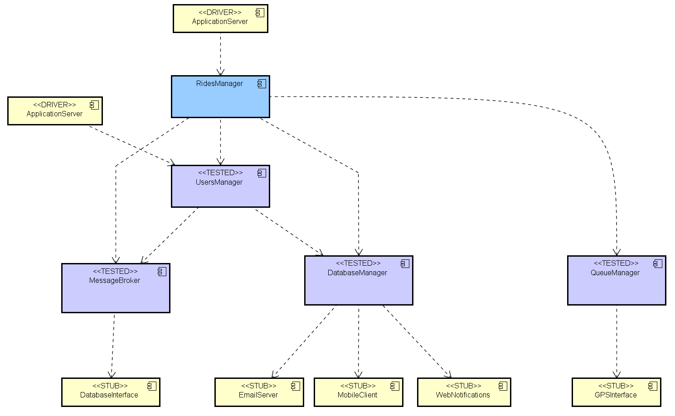
Next step:
Application Server Integration
Step 3: RidesManager.

Slide 35
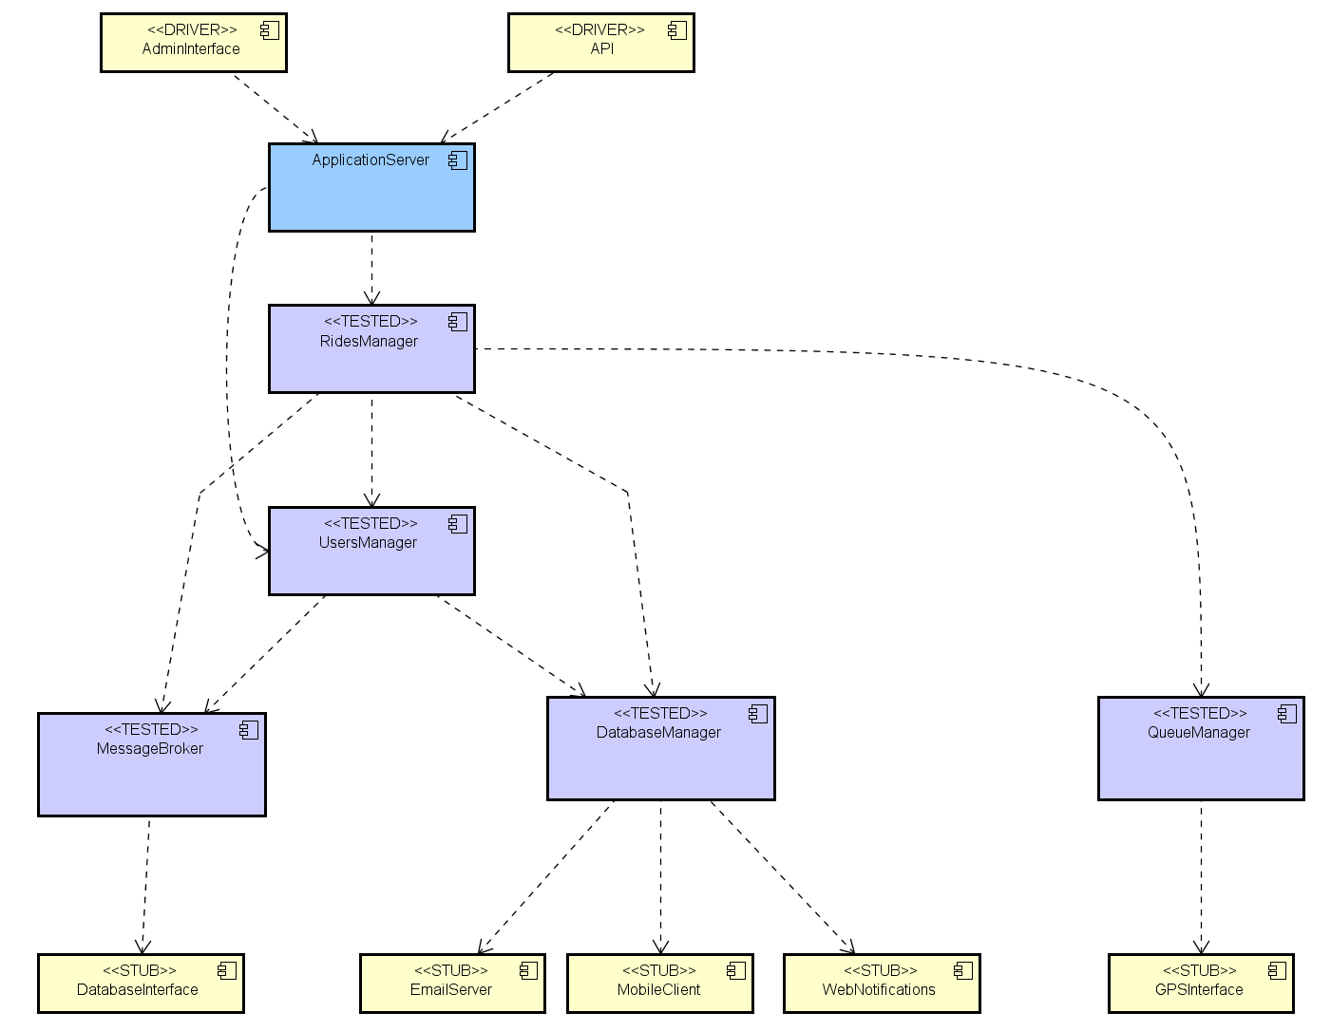
This was the last component!
Step 4: Application Server.

Slide 36
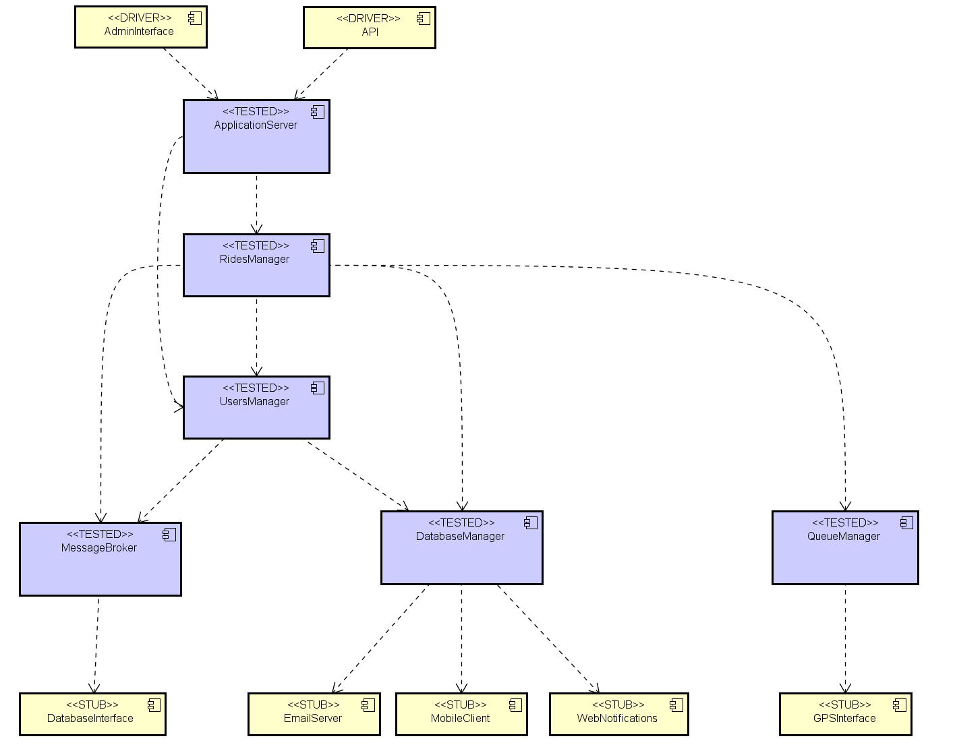
Final result: all components tested.

Slide 37
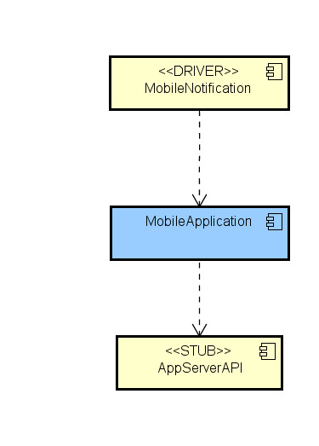
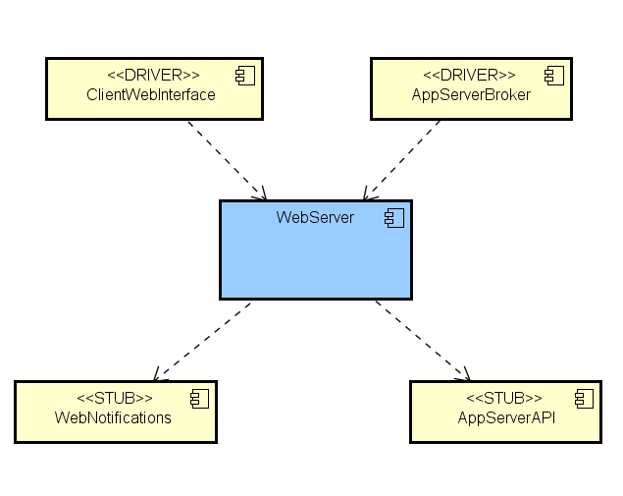
Web Server and Client
Web Server
Client
As said before, Client and Web Server can be tested alone, using only stubs and drivers.

Slide 38
Cost Estimation

Slide 39
Function Points – Measurement parameters
Most of the operations and data files have been considered of simple or medium complexity.
Criteria used:
Internal / External logical files
SIMPLE
Few basic fields
Not related with other data structures
Example: User, Taxi.
MEDIUM
Many fields, possibly critical
Non basic data structures (e.g. graphs)
Example: Rides, City Zones
External input / output / inquiries
SIMPLE
Basic functionalities
Little or no data processing
Example: Login, Logout.
MEDIUM
More data processing or data retrival
May involve multiple type of data
Example: Request a taxi, Visualize the rides history.

Slide 40
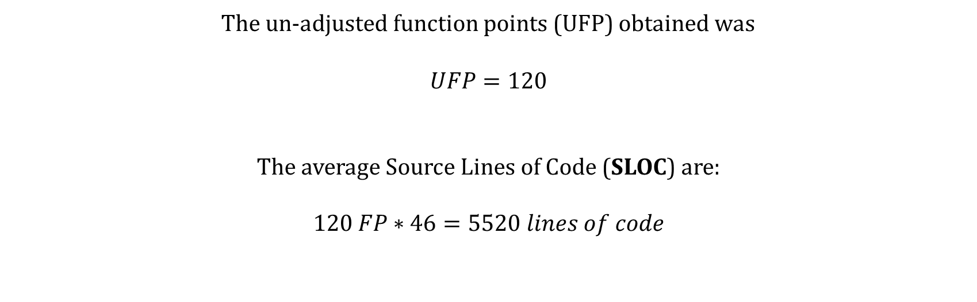
Function Points
The un-adjusted function points (UFP) obtained was
$$UFP=120$$
The average Source Lines of Code (SLOC) are:
$$120 FP∗46=5520 lines of code$$

Slide 41
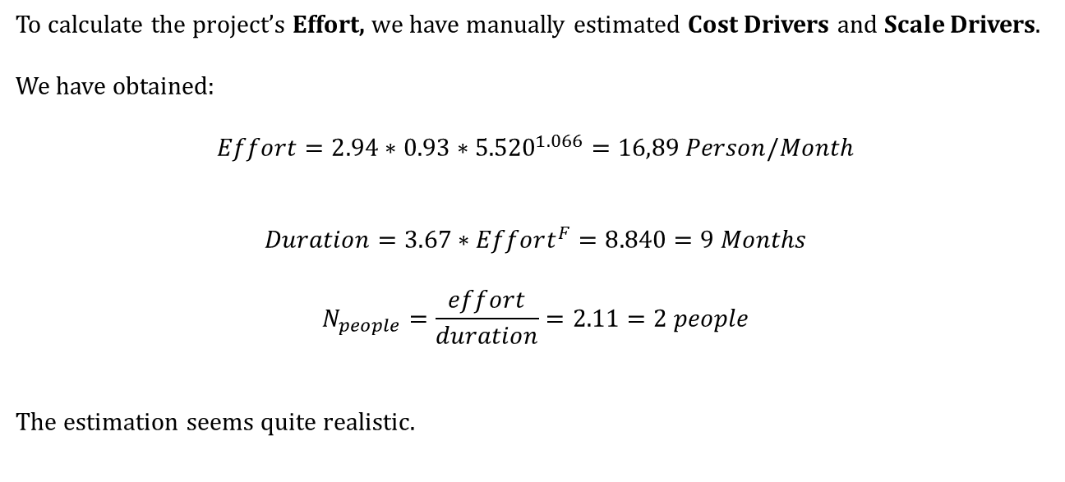
COCOMO II
To calculate the project’s Effort, we have manually estimated Cost Drivers and Scale Drivers.
We have obtained:
$$Effort=2.94∗0.93∗{5.520}^{1.066}=16,89 Person/Month$$
$$Duration=3.67∗Effort^{F}=8.840=9 Months$$
$$N_{people}=\frac{effort}{duration}=2.11=2 people$$
The estimation seems quite realistic.

Slide 42
Thank you!

